Slide 1

Weekly Update 9
Sarang Deb Saha

Slide 2
Problem with the dataset
IUDX platform problem
Problem with 5 days (262MB) and the 10hr (65MB) data in json format
Further analysis for the time being is done on a 30 min data (2.5MB)
[9366 data points]

Slide 3
Dataset Issues
5-day Data | 10-hr Data | 30-min Data
[{"cameraUsage":"ANPR","alertType":"STOP_LINE_VIOLATION","id":"5b778007-797e-4313-b34c-c7c4812365bb","location":{"coordinates":[77.576809,12.948272],"type":"Point"},"junctionName":"VanivilasJN","vehicleType":"Undetermined","observationDateTime":"2024-03-12T14:23:05+05:30"}] | [{"cameraUsage":"ANPR","alertType":"LICENCE_PLATE_RECOGNITION","id":"5b778007-797e-4313-b34c-c7c4812365bb","location":{"coordinates":[77.645087,12.985709],"type":"Point"},"junctionName":"80feetoldmadradroad","vehicleType":"Auto","observationDateTime":"2024-03-10T06:30:02+05:30"}] | [{"id":"5b778007-797e-4313-b34c-c7c4812365bb","cameraUsage":"ANPR","alertType":"LICENCE_PLATE_RECOGNITION","location":{"type":"Point","coordinates":[77.553042,12.998237]},"observationDateTime":"2024-03-10T05:30:00+05:30","junctionName":"Navarangacircle","vehicleType":"Car"}]
start_time = "2024-03-10T05:00:00+05:30" end_time = "2024-03-15T05:30:00+05:30" | start_time = "2024-03-10T05:00:00+05:30" end_time = "2024-03-10T15:30:00+05:30" | start_time = "2024-03-10T05:00:00+05:30" end_time = "2024-03-10T05:30:00+05:30"
First datapoint- Stop Line Violation @VanivilasJN | First datapoint- License Plate Recognition @80feetoldmadradroad | First datapoint- License Plate Recognition @Navarangacircle

Slide 4
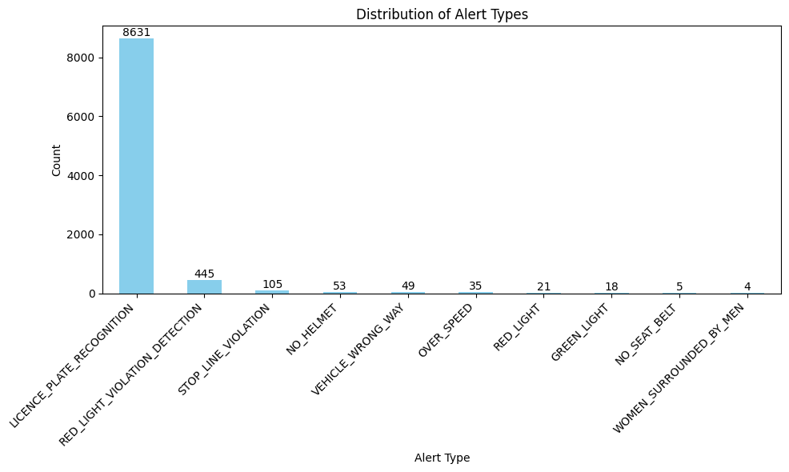
Frequency distribution based on Alert Types

Slide 5
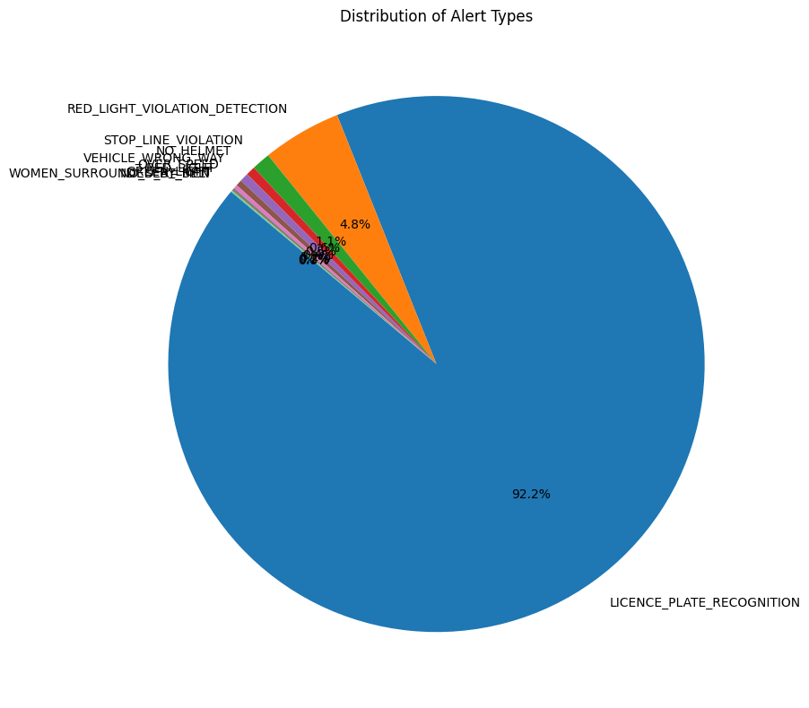
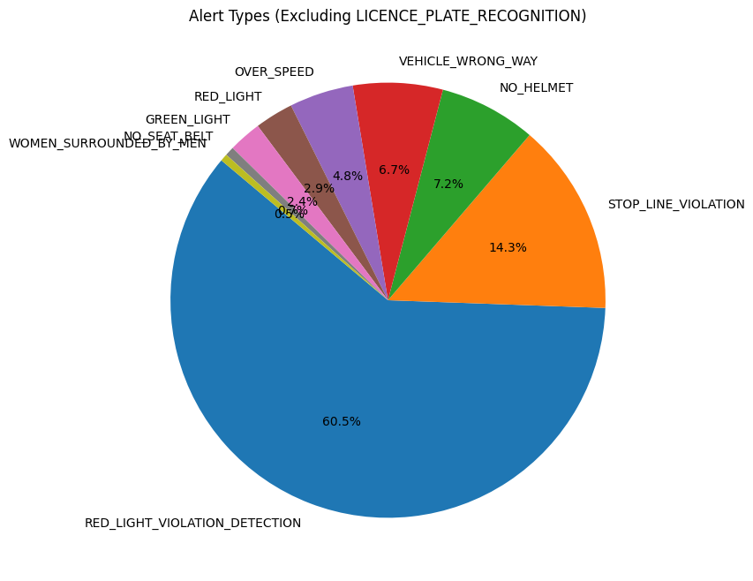

Slide 6
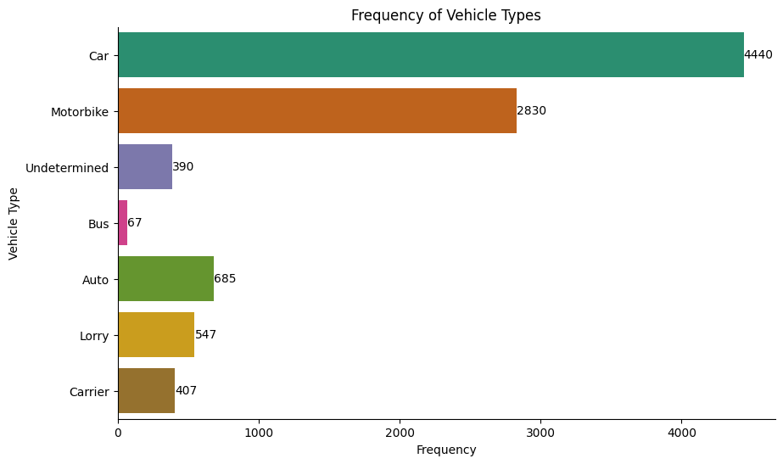
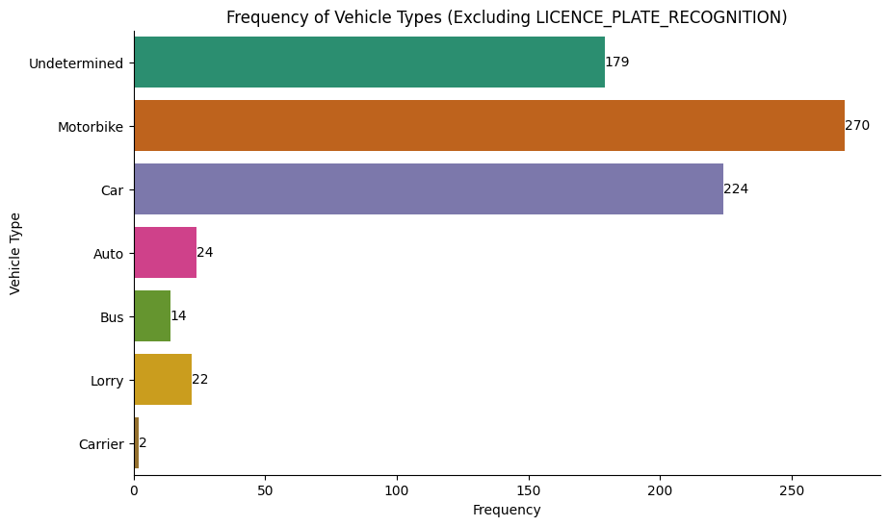
Frequency distribution based on Vehicle Types

Slide 7
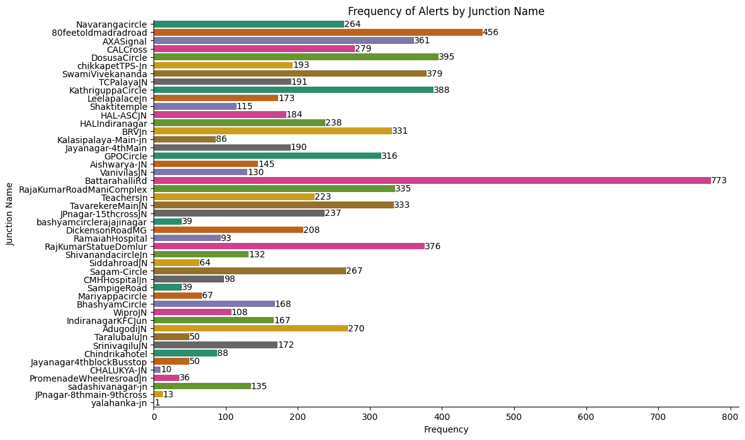
Frequency of Alerts by Junction Name
47 Junctions

Slide 8
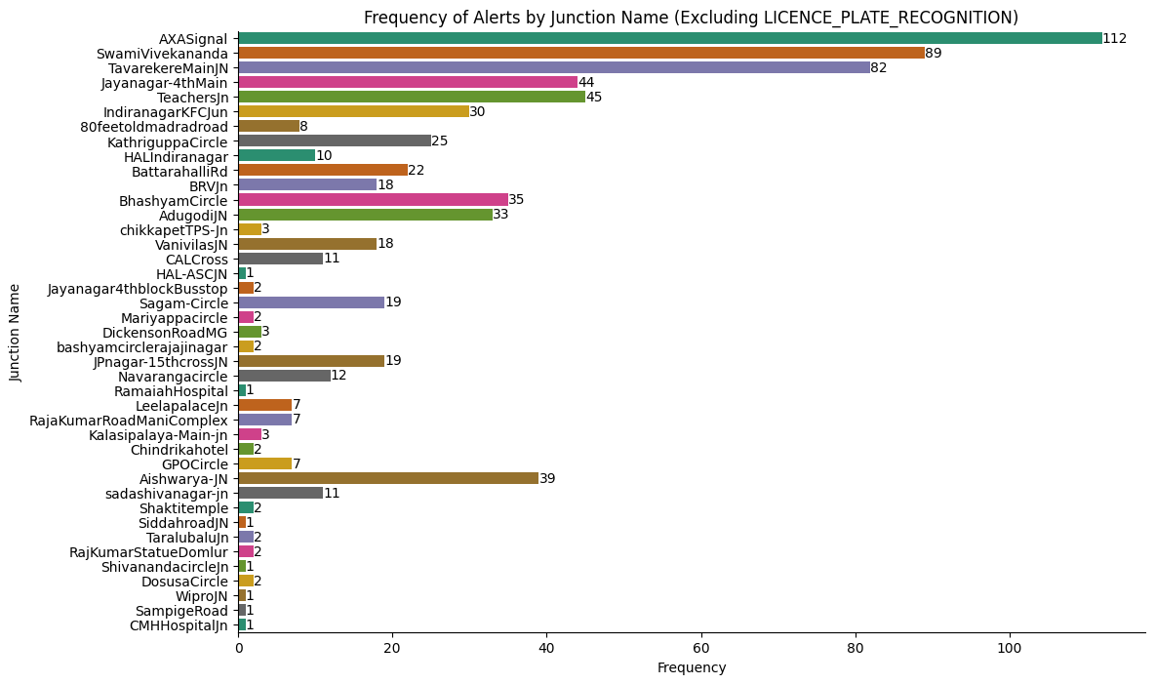

Slide 9
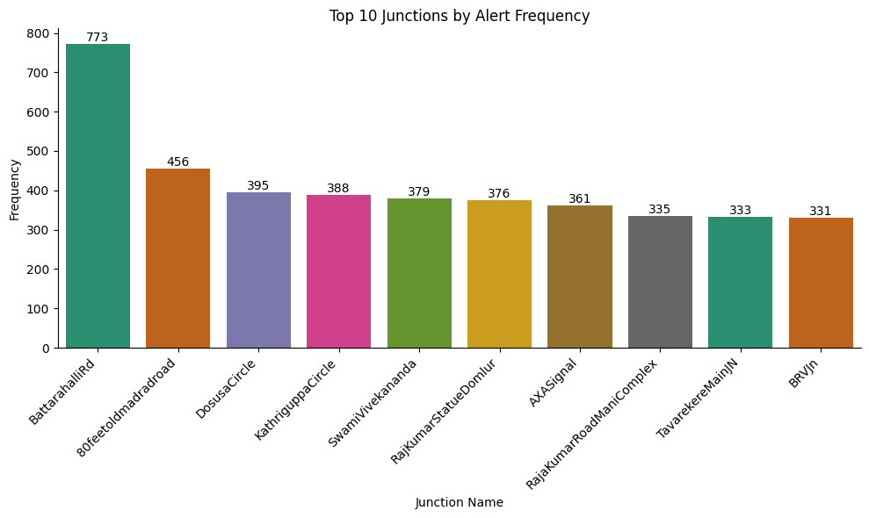
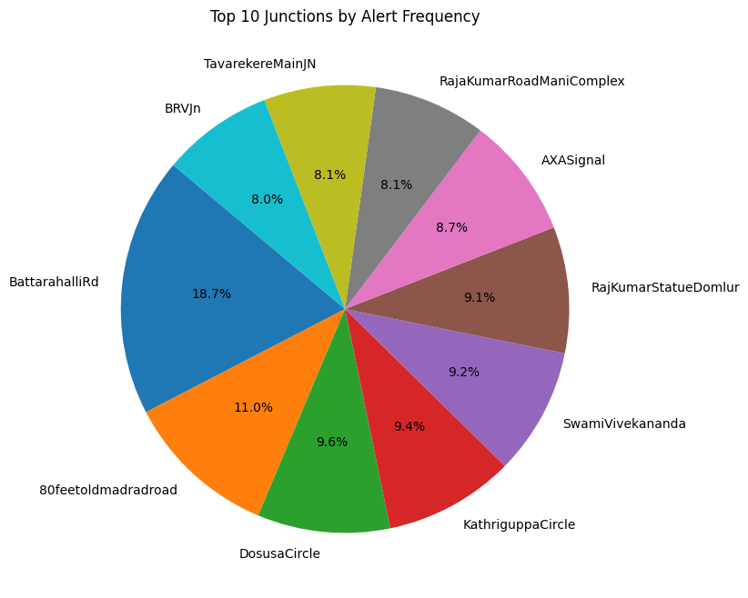

Slide 10
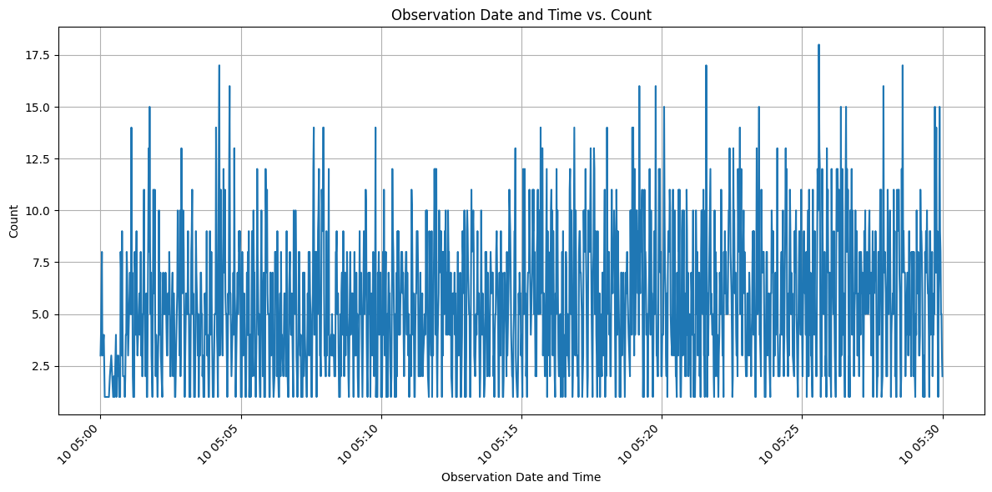
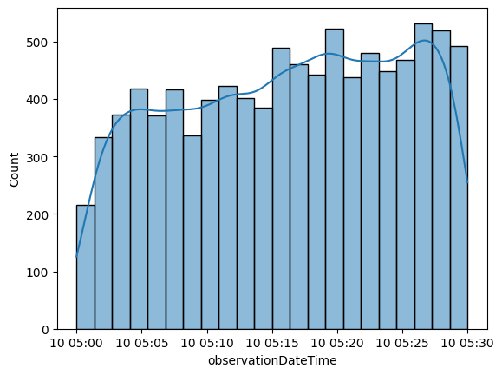
ObservationDateTime vs Count

Slide 11
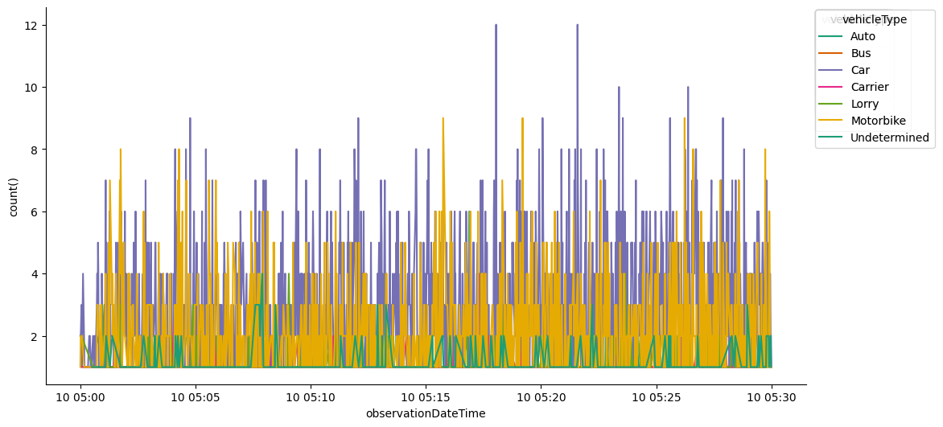

Slide 12
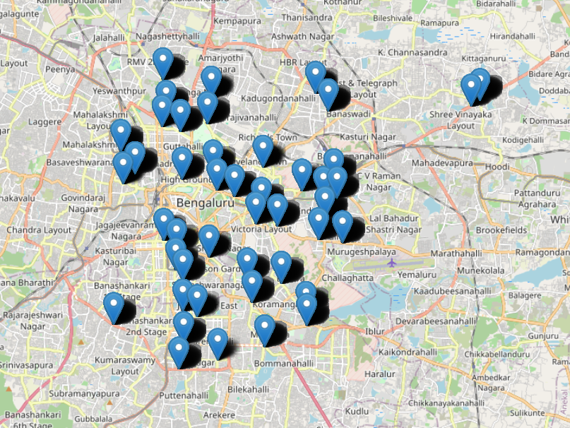
Basic map plot using folium

Slide 13
Abstract (potential)
Road safety remains a critical concern in urban areas, with junctions often serving as hotspots for various traffic violations. This study presents a comprehensive analysis of road violence and detection events occurring at different road junctions in Bengaluru. Leveraging a robust system, we collected data on instances of red light violations, stop line violations, and other traffic infractions. Through meticulous analysis, we identify key factors contributing to these violations, including time of day, weather conditions, junction characteristics, and cycle length. Our findings reveal distinct patterns and correlations between these factors and the prevalence of violations.
Furthermore, we develop a predictive model utilizing machine learning techniques to forecast the likelihood of road violations at specific junctions and also predict the type of violation likely to occur. By training our model on historical event data, we demonstrate its efficacy in anticipating potential infractions with high accuracy. This predictive capability not only enables proactive intervention by law enforcement agencies but also facilitates the implementation of targeted strategies for improving road safety and reducing traffic incidents.
Overall, this study contributes valuable insights into the dynamics of road violations at junctions in Bengaluru and offers a practical framework for enhancing traffic management and safety measures in urban environments. By harnessing data-driven approaches, we aim to mitigate the risks associated with reckless driving behaviors, ultimately fostering safer and more sustainable transportation systems.

